Slide 1
19CSE211 COMPUTER ARCHITECTURE & ORGANIZATION
Single Cycle Implementation-Continuation

Slide 2
Datapath for lw-sw, ALU Operations and Branches

Slide 3
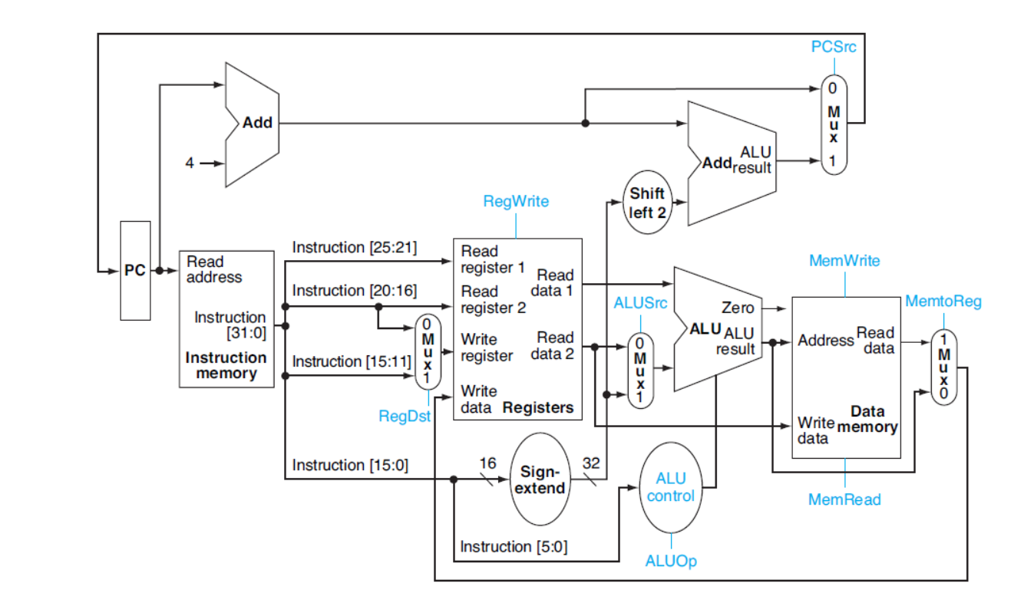
ALU Control Unit

Slide 4
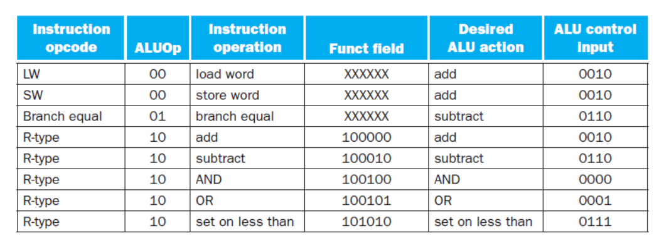
ALUOp Control(2 bit) and 6 bit Funct field

Slide 5
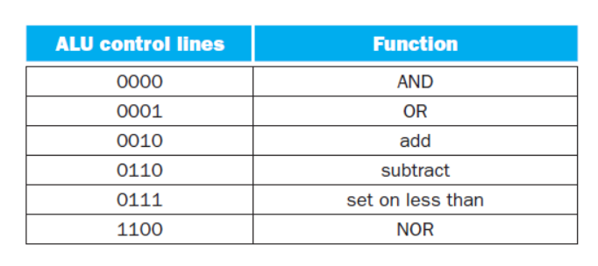
ALUControlLines-4 bits

Slide 6
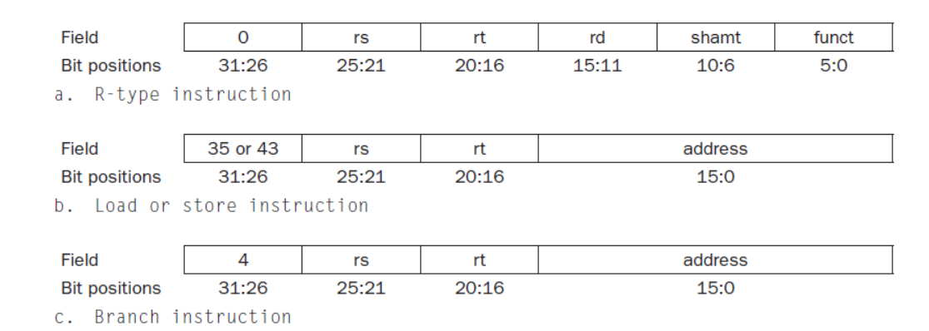
Three Instruction Classes where Op[5:0] –Opcode field

Slide 7
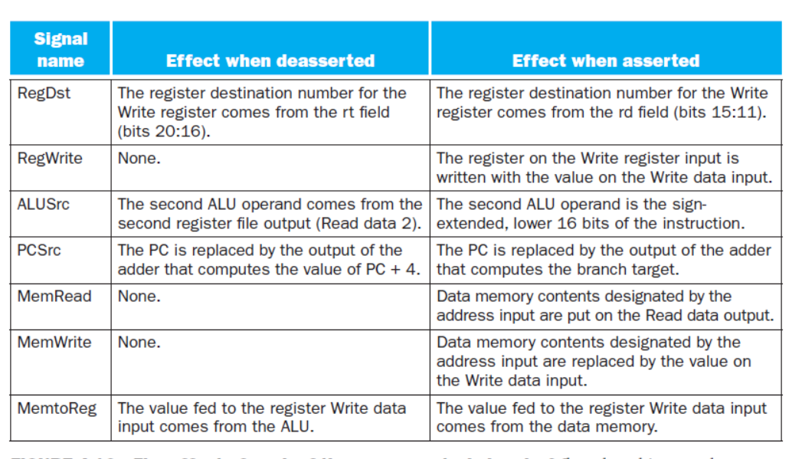
Seven Control Signals

Slide 8
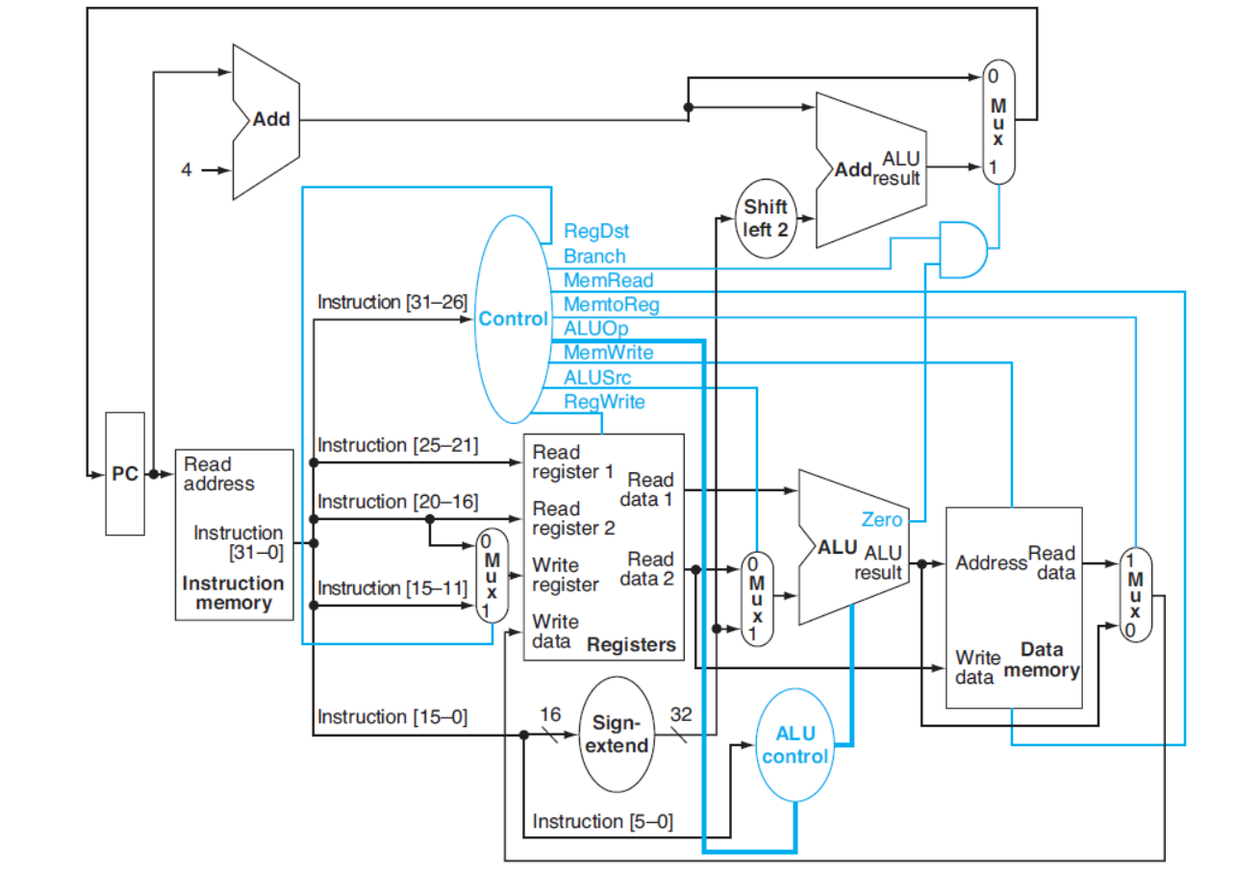
Simple DataPath with Control Unit

